Slide 1
OOP
WEEK10 MUHAMMAD NAEEM AKHTAR

Slide 2
Contents
Lec 09 | Inheritance, Levels of inheritance (Multiple, Multi-level), Diamond Problem | Text Book Chapter: 12 Text Book Ch: 24 Section: 24.7 & 24.8 (for diamond problem)

Slide 3
C++ Inheritance
In C++, inheritance is a process in which one object acquires all the properties and behaviors of its parent object automatically.
In such way, you can reuse, extend or modify the attributes and behaviors which are defined in other class.
In C++, the class which inherits the members of another class is called derived class and the class whose members are inherited is called base class.
The derived class is the specialized class for the base class.

Slide 4
Discussion
When we say derived class inherits the base class, it means, the derived class inherits all the properties of the base class, without changing the properties of base class and may add new features to its own.
These new features in the derived class will not affect the base class.
The derived class is the specialized class for the base class.
Code reusability: Now you can reuse the members of your parent class. So, there is no need to define the member again. So less code is required in the class.

Slide 5
Terminology
Sub Class: The class that inherits properties from another class is called Subclass or Derived Class or Child Class.
Super Class: The class whose properties are inherited by a subclass is called Base Class or Superclass or Parent Class.

Slide 6
Why and when to use inheritance?
Consider a group of vehicles. You need to create classes for Bus, Car, and Truck.
The methods
fuelAmount(),
capacity(),
applyBrakes() will be the same for all three classes.
If we create these classes avoiding inheritance then we have to write all of these functions in each of the three classes as shown in figure on next slides.

Slide 7
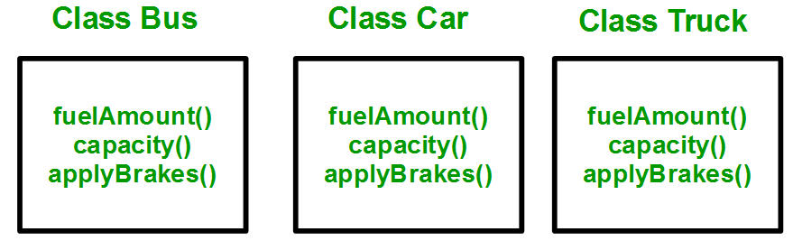
Why and when to use inheritance?

Slide 8
Why and when to use inheritance?
You can clearly see that the above process results in duplication of the same code 3 times.
This increases the chances of error and data redundancy.
To avoid this type of situation, inheritance is used.
If we create a class Vehicle and write these three functions in it and inherit the rest of the classes from the vehicle class, then we can simply avoid the duplication of data and increase re-usability.
Look at the diagram on next slide in which the three classes are inherited from vehicle class:

Slide 9
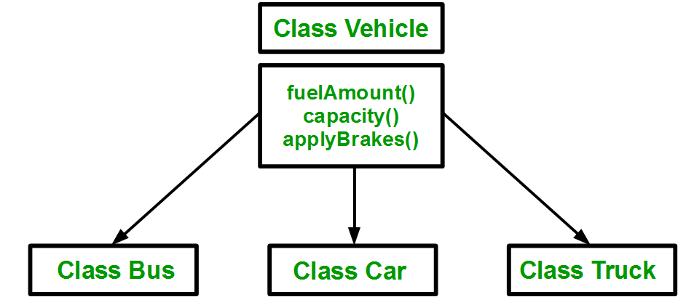
Why and when to use inheritance?

Slide 10
Implementing inheritance in C++
Syntax:
class <derived_class_name> : <access-specifier> <base_class_name>
{
//body
}
Notes:
Syntax:
class <derived_class_name> : <access-specifier> <base_class_name> { //body }

Slide 11
Implementing inheritance in C++
Syntax explanation class---keyword to create a new class derived_class_name---name of the new class, which will inherit the base class access-specifier --- either of private, public or protected. If neither is specified, PRIVATE is taken as default base-class-name --- name of the base class
Note: A derived class doesn’t inherit access to private data members. However, it does inherit a full parent object, which contains any private members which that class declares.
Notes:
Syntax:
class <derived_class_name> : <access-specifier> <base_class_name> { //body }

Slide 12
What is meant by access specifiers in inheritance?
When a base class is privately inherited by the derived class, public members of the base class becomes the private members of the derived class and therefore, the public members of the base class can only be accessed by the member functions of the derived class. They are inaccessible to the objects of the derived class.
On the other hand, when the base class is publicly inherited by the derived class, public members of the base class also become the public members of the derived class. Therefore, the public members of the base class are accessible by the objects of the derived class as well as by the member functions of the derived class.

Slide 13
Modes of Inheritance
There are 3 modes of inheritance.
Public Mode: If we derive a subclass from a public base class. Then the public member of the base class will become public in the derived class and protected members of the base class will become protected in the derived class.
Protected Mode: If we derive a subclass from a Protected base class. Then both public members and protected members of the base class will become protected in the derived class.
Private Mode: If we derive a subclass from a Private base class. Then both public members and protected members of the base class will become Private in the derived class.

Slide 14
Examples
Example: 1. class ABC : private XYZ //private derivation { } 2. class ABC : public XYZ //public derivation { } 3. class ABC : protected XYZ //protected derivation { } 4. class ABC: XYZ //private derivation by default { }

Slide 15
Note
The private members in the base class cannot be directly accessed in the derived class, while protected members can be directly accessed. For example, Classes B, C, and D all contain the variables x, y, and z in the below example. It is just a question of access.
See example codes:
Private_inheritance_e1.cpp
Public_inheritance_e1.cpp
Protected_inheritance_e1.cpp

Slide 16
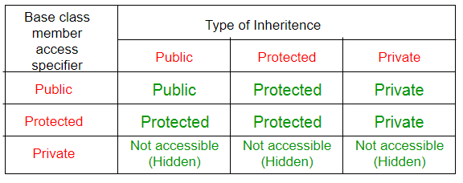
Modes of Inheritance Summary

Slide 17
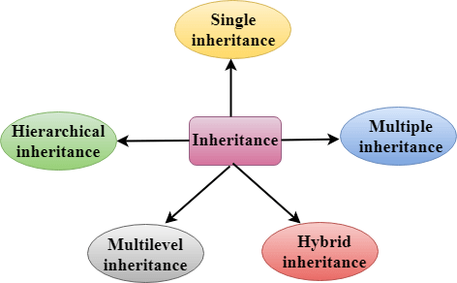
Types of Inheritance

Slide 18
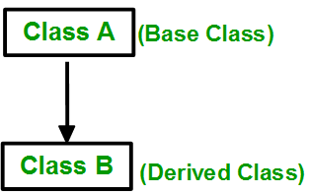
Types of Inheritance
Single Inheritance: In single inheritance, a class is allowed to inherit from only one class. i.e. one subclass is inherited by one base class only.
See example: Single_Inheritance.cpp

Slide 19
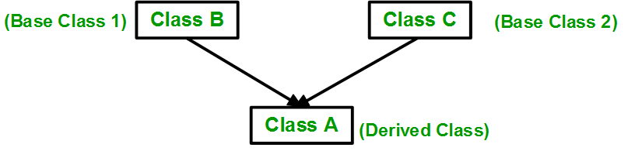
Types of Inheritance
2. Multiple Inheritance: Multiple Inheritance is a feature of C++ where a class can inherit from more than one class. i.e one subclass is inherited from more than one base class.
See example: Multiple_Inheritance.cpp

Slide 20
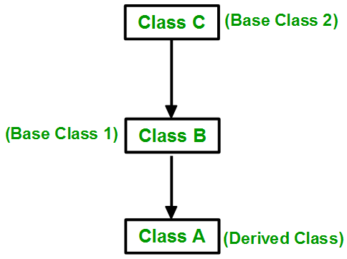
Types of Inheritance
3. Multilevel Inheritance: In this type of inheritance, a derived class is created from another derived class.
See example: Multilevel_Inheritance.cpp

Slide 21
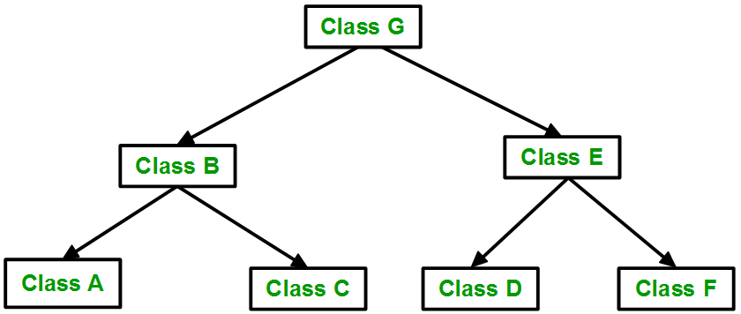
Types of Inheritance
4. Hierarchical Inheritance: In this type of inheritance, more than one subclass is inherited from a single base class. i.e. more than one derived class is created from a single base class.
See example: Hierarchical_Inheritance.cpp

Slide 22
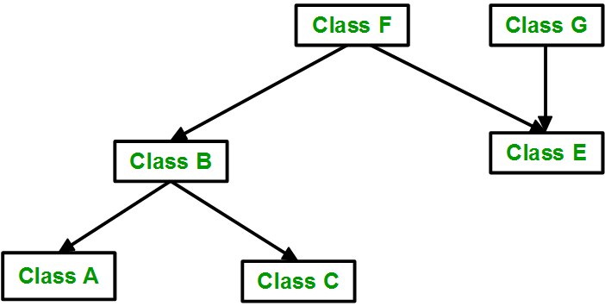
Types of Inheritance
5. Hybrid (Virtual) Inheritance: Hybrid Inheritance is implemented by combining more than one type of inheritance. For example: Combining Hierarchical inheritance and Multiple Inheritance. Below image shows the combination of hierarchical and multiple inheritances:
See example: Hybrid_ Inheritance.cpp

Slide 23
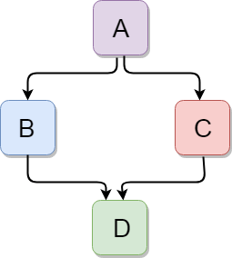
Types of Inheritance
6. A special case of hybrid inheritance: Multipath inheritance: A derived class with two base classes and these two base classes have one common base class is called multipath inheritance. Ambiguity can arise in this type of inheritance.
Also called diamond problem.
See example: Multipath_Inheritance.cpp

Slide 24
Diamond Problem
In the above example, both ClassB and ClassC inherit ClassA, they both have a single copy of ClassA. However Class-D inherits both ClassB and ClassC, therefore Class-D has two copies of ClassA, one from ClassB and another from ClassC.
If we need to access the data member of ClassA through the object of Class-D, we must specify the path from which a will be accessed, whether it is from ClassB or ClassC, bcoz compiler can’t differentiate between two copies of ClassA in Class-D.

Slide 25
How to avoid ambiguity?
There are 2 Ways to Avoid this Ambiguity:
Avoiding ambiguity using the scope resolution operator: Using the scope resolution operator we can manually specify the path from which data member a will be accessed, as shown in statements 3 and 4, in the above example (Multipath_Inheritance.cpp)
obj.ClassB::a = 10; // Statement 3
obj.ClassC::a = 100; // Statement 4
Note: Still, there are two copies of ClassA in Class-D.

Slide 26
How to avoid ambiguity?
2. Avoiding ambiguity using the virtual base class:
See example: Virtualbaseclass.cpp
Note: Only one copy of variable a of class A exist in D now

